Slide 1
Random Variables and Their Distributions
Chapter 5 (sec. 5.1-5.4)
Chap 5-<number>

Slide 2
Learning Objectives
This week, we learn:
The notion of random variables
The properties of a probability distribution
To compute the expected value and variance of a probability distribution
To compute probabilities from binomial and Poisson distributions
How the binomial and Poisson distributions can be used to solve business problems
Applications to Finance
Chap 5-<number>

Slide 3
Definitions
Random variable is a quantity that depends on chance.
Example: gender of 3 children (tossing 3 coins).
Let X be the number of girls. X is unknown but we know this:
X can be 0, 1, 2, or 3.
{X=0}, {X=1}, {X=2}, {X=3} are events, they have probabilities.
Chap 5-<number>

Slide 4
Random variables, example
X is the number of girls in a family of 3 children.
Value of X | Probability | Equally likely outcomes
0 | 1/8 | BBB
1 | 3/8 | GBB, BGB, BBG
2 | 3/8 | GGB, GBG, BGG
3 | 1/8 | GGG
G=girl, B=boy
A coin is tossed 3 times. X is the number of heads.
Same values, same probabilities. Same distribution.

Slide 5
Types Of Variables
Types Of
Variables
Ch. 5
Ch. 5
Ch. 5
Ch. 6
Ch. 6
Discrete
Random Variable
Ch. 6
Discrete
Random Variable
Discrete
Variable
Continuous
Random Variable
Continuous
Random Variable
Continuous
Variable
Discrete variables take only separate, isolated values.
Continuous variables can take any value in an interval.

Slide 6
Discrete Random Variables
Can only assume a countable number of values
  Examples:
  Roll a die
  Let X be the number of dots.
  Number of shares bought
  Number of satisfied customers
  Proportion of satisfied customers, in a sample of 100

Slide 7
Probability Distribution For A Discrete Random Variable
A probability distribution for a discrete random variable is a list of its all possible values along with the corresponding probabilities.
Example:
x values of X | P(x) probabilities
0 | 1/8
1 | 3/8
2 | 3/8
3 | 1/8
Chap 5-<number>

Slide 8
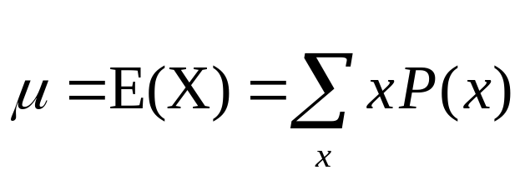
Expected Value
Expected Value (or mean) of a discrete
variable is (Weighted Average)
  Example: Toss 2 coins,
  X = # of heads,
  compute expected value of X:
E(X) = (0)(0.25) + (1)(0.50) + (2)(0.25)
= 1.0
x P(x)
0 0.25
1 0.50
2 0.25
Chap 5-<number>

Slide 9
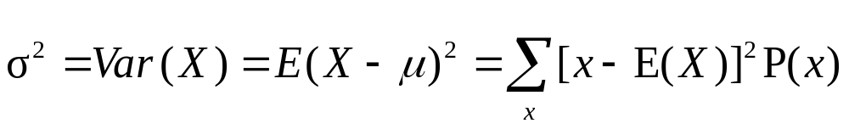
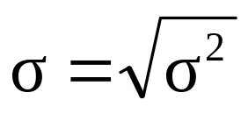
Variance and Standard Deviation
Variance of a discrete random variable
Standard Deviation of a discrete random variable
Chap 5-<number>

Slide 10
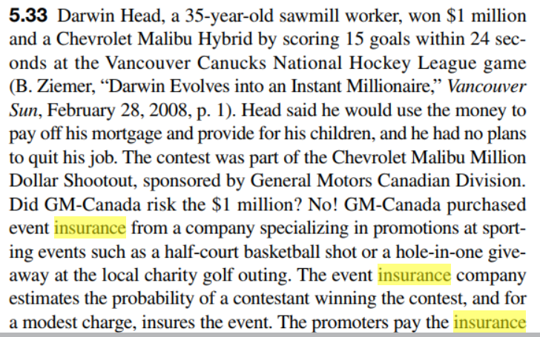
Example
#5.33 on page 183
Chap 5-<number>

Slide 11
Covariance and Applications to Finance
Section 5.4
.
Chap 5-<number>

Slide 12
Covariance
The covariance measures the strength of the linear relationship between two discrete random variables X and Y.
A positive covariance indicates a positive relationship.
A negative covariance indicates a negative relationship.
.
Chap 5-<number>

Slide 13
The Covariance Formula
The covariance formula:
where: X = discrete random variable X
x = value of X
Y = discrete random variable Y
y = value of Y
P(x,y) = P(X=x and Y=y)
= probability of a joint event {X=x and Y=y}
.
Chap 5-<number>

Slide 14
Investment Returns
The Mean
Consider the return per $1000 for two types of investments.
Economic Condition Prob. | Investment
 | Passive Fund X | Aggressive Fund Y
0.2 Recession | - $25 | - $200
0.5 Stable Economy | + $50 | + $60
0.3 Expanding Economy | + $100 | + $350
.
Chap 5-<number>

Slide 15
Investment Returns
The Mean
E(X) = μ_{X} = (-25)(.2) +(50)(.5) + (100)(.3) = 50
E(Y) = μ_{Y} = (-200)(.2) +(60)(.5) + (350)(.3) = 95
Interpretation: Fund X is averaging a $50.00 return and fund Y is averaging a $95.00 return per $1000 invested.
These are expected returns.
.
Chap 5-<number>

Slide 16
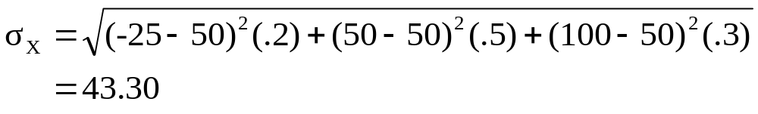
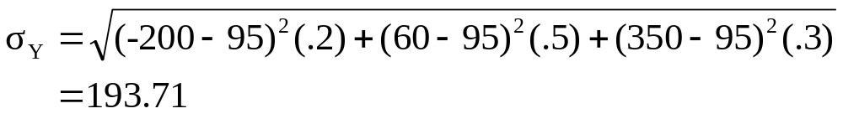
Investment Returns
Standard Deviation
Interpretation: Even though fund Y has a higher average return, it is subject to much more variability.
.
Chap 5-<number>

Slide 17
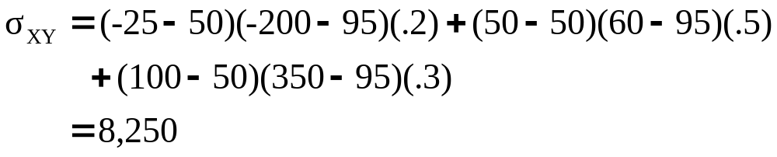
Investment Returns
Covariance
Interpretation: Since the covariance is large and positive, there is a positive relationship between the two investment funds, meaning that they will likely rise and fall together.
.
Chap 5-<number>

Slide 18
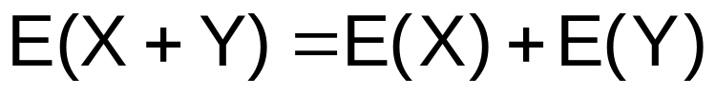
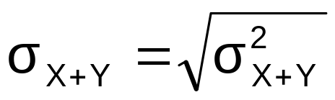
The Sum of
Two Random Variables
Expected Value of the sum of two random variables:
Variance of the sum of two random variables:
Standard deviation of the sum of two random variables:
.
Chap 5-<number>

Slide 19
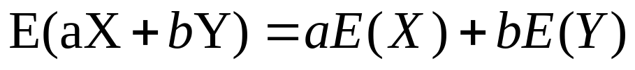
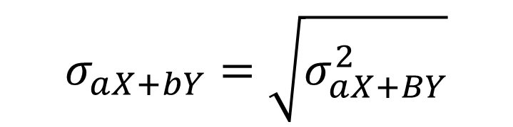
The Weighted Sum
Two Random Variables
Expected Value of a weighted sum:
Variance of a weighted sum:
Standard deviation of a weighted sum:
Chap 5-<number>

Slide 20
Portfolio Expected Return and Expected Risk
Investment portfolios usually contain several different funds (random variables)
Investment Objective: Maximize expected return (mean) while minimizing risk (standard deviation).
.
Chap 5-<number>

Slide 21
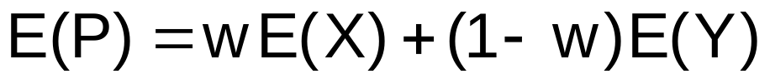
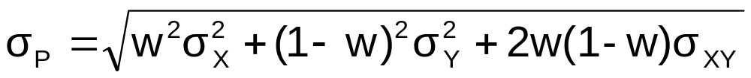
Portfolio Expected Return and Portfolio Risk
Consider a portfolio with:
w = proportion of portfolio value in asset X
(1 - w) = proportion of portfolio value in asset Y
Portfolio expected return (weighted average return):
Portfolio risk (weighted variability)
.
Chap 5-<number>

Slide 22
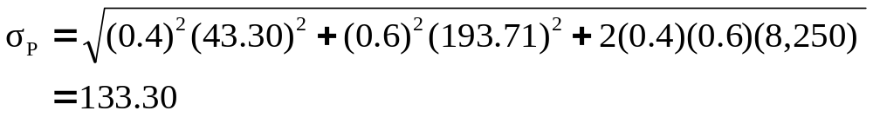
Portfolio Example 1
Investment X: μ_{X} = 50 σ_{X} = 43.30
Investment Y: μ_{Y} = 95 σ_{Y} = 193.21
σ_{XY} = 8250
Suppose 40% of the portfolio is in Investment X and 60% is in Investment Y:
The portfolio return and portfolio variability are always between
the values for investments X and Y considered individually
.
Chap 5-<number>

Slide 23
Portfolio Example 2
We would like to invest $10,000 into companies A and B. Shares of A cost $20 per share. The market analysis shows that their expected return is $1 per share with a standard deviation of $0.5. Shares of B cost $50 per share, with an expected return of $2.50 and a standard deviation of $1 per share, and returns from the two companies are independent.
What is the most optimal portfolio consisting of shares of A and B, in terms of the maximum expected return at the minimum risk? How does the answer change if returns from A and B are correlated?
.
Chap 5-<number>

Slide 24
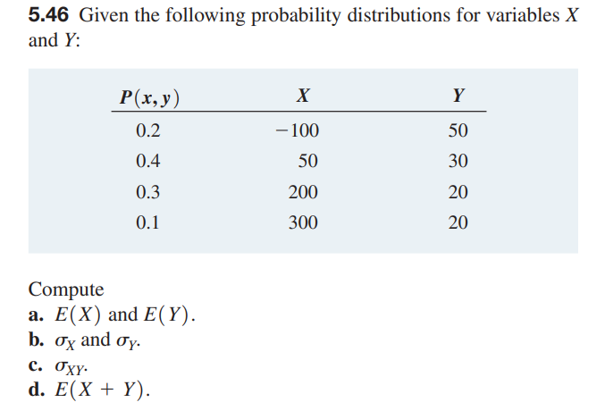
Portfolio Example 3
.

Slide 25
Probability Distributions Commonly Used in Business
Probability Distributions
Ch. 5
Discrete
Probability Distributions
Continuous
Probability Distributions
Ch. 6
Binomial
Normal
Poisson
Uniform
Geometric, Hypergeometric, and others
Exponential, Gamma, Weibull, and others
Chap 5-<number>

Slide 26
Bernoulli Distribution
The simplest non-trivial distribution:
X takes two values, X=0 and X=1
(Bernoulli trials have two outcomes - pass and fail, good and defective, girl and boy, “success” and “failure”).
Distribution of X:
P(X=1) = P(1) = π = probability of a success
P(X=0) = P(0) = 1-π = probability of a failure
E(X) = π, Var(X) = π(1-π)
Chap 5-<number>

Slide 27
Binomial Distribution
X = number of “successes” in n independent Bernoulli trials
Examples:
number of A grades
number of defective products
number of votes for a particular candidate
number of games won
number of Stanley Cups won
etc.
Chap 5-<number>

Slide 28
Business Applications of the Binomial Distribution
A manufacturing plant labels items as either defective or acceptable
A firm bidding for contracts will either get a contract or not
A marketing research firm receives survey responses of “yes I will buy” or “no I will not”
New job applicants either accept the offer or reject it
Chap 5-<number>

Slide 29
Binomial Distribution Formula
n
!
P(X=x |n,π)
=
x
n
−
x
π
(1-π)
x!
(
−
)
n
x
!
P(X=x|n,π) = probability of x events of interest in n trials, with the probability of an “event of interest” being π for each trial
x = number of “events of interest” in sample,
(x = 0, 1, 2, ..., n)
n = sample size (number of trials
or observations)
π = probability of “event of interest”
Example: Flip a coin four times, let X = # heads:
n = 4
π = 0.5
1 - π = (1 - 0.5) = 0.5
X = 0, 1, 2, 3, 4
Chap 5-<number>

Slide 30
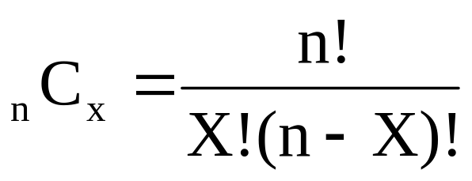
Counting Techniques
Rule of Combinations
The number of combinations of selecting X objects out of n objects is
where:
n! =(n)(n - 1)(n - 2) . . . (2)(1)
X! = (X)(X - 1)(X - 2) . . . (2)(1)
0! = 1 (by definition)
Here, we have X successes in n Bernoulli trials
Chap 5-<number>

Slide 31
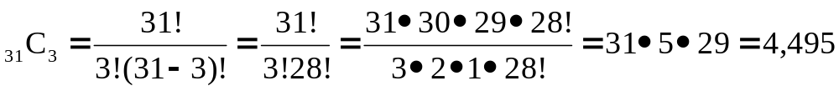
Counting Techniques
Rule of Combinations
How many possible 3 scoop combinations could you create at an ice cream parlor if you have 31 flavors to select from?
The total choices is n = 31, and we select X = 3.
Chap 5-<number>

Slide 32
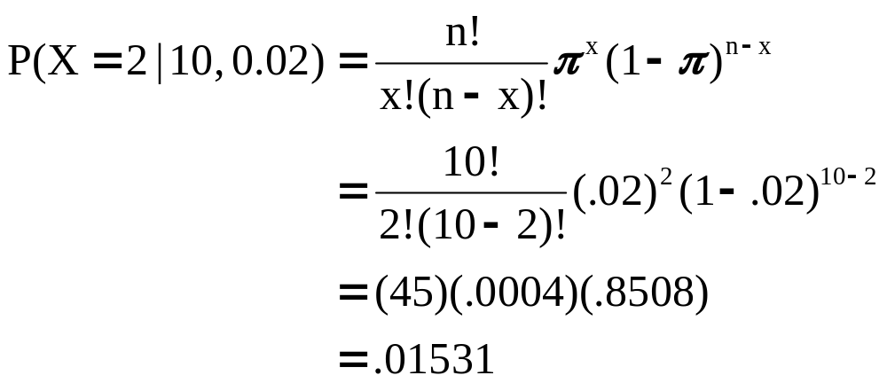
The Binomial Distribution
Example
Suppose the probability of purchasing a defective computer is 0.02. What is the probability of purchasing 2 defective computers in a group of 10?
x = 2, n = 10, and π = 0.02
Chap 5-<number>

Slide 33
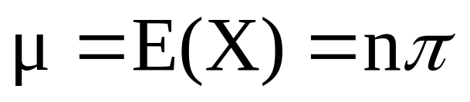
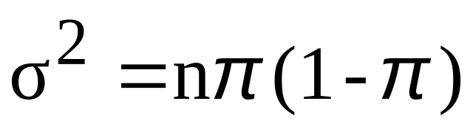
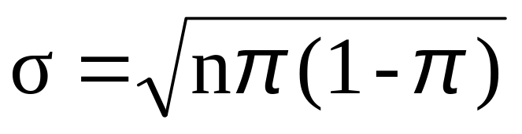
Binomial Distribution Characteristics
Mean
Variance and Standard Deviation
Where n = sample size
π = probability of the event of interest for any trial
(1 – π) = probability of no event of interest for any trial
Chap 5-<number>

Slide 34
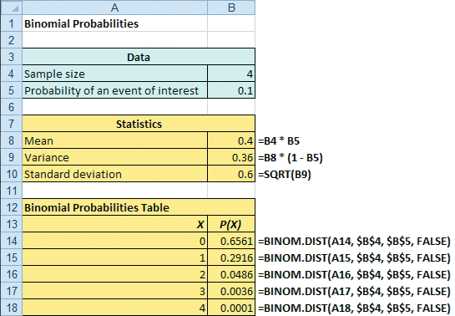
Using Excel For The
Binomial Distribution
π
π
Chap 5-<number>

Slide 35
Examples
#5.15, pages 177-178
Chap 5-<number>

Slide 36
Poisson Distribution
Poisson distribution describes a number of unexpected events that occur independently, one by one, at random times
  The number of scratches in a car’s paint
  The number of mosquito bites on a person
  The number of computer crashes in a day
  The number of thunderstorms in a given month
  The number of traffic accidents in a given day
  The number of calls to a customer service
Chap 5-<number>

Slide 37
The Poisson Distribution
Apply the Poisson Distribution when:
  You wish to count the number of times an event occurs in a given area of opportunity
  The probability that an event occurs in one area of opportunity is the same for all areas of opportunity
  The number of events that occur in one area of opportunity is independent of the number of events that occur in the other areas of opportunity
  The probability that two or more events occur in an area of opportunity approaches zero as the area of opportunity becomes smaller
  The average number of events per unit is λ (lambda)
Chap 5-<number>

Slide 38
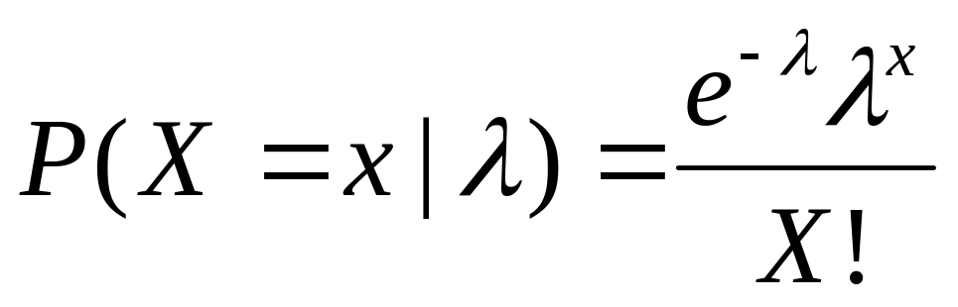
Poisson Distribution Formula
where:
x = number of events in an area of opportunity
λ = expected number of events
e = base of the natural logarithm system (2.71828...)
Chap 5-<number>

Slide 39
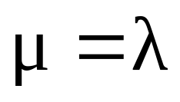
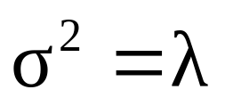
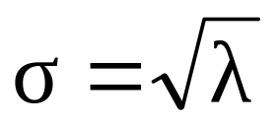
Poisson Distribution Characteristics
Mean
Variance and Standard Deviation
where λ = expected number of events
Chap 5-<number>

Slide 40
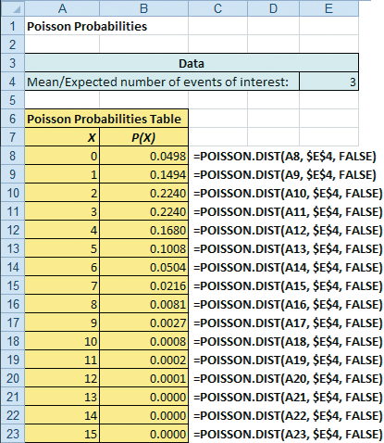
Using Excel For The
Poisson Distribution
Chap 5-<number>

Slide 41
Deciding between Binomial and Poisson distribution:
1. The meaning of X:
Binomial variable = number of “successes” in n trials
Poisson variable = number of events that occur unexpectedly at random times
Chap 5-<number>

Slide 42
Deciding between Binomial and Poisson distribution:
2. Possible values of X.
Binomial X = 0 through n
Poisson X = from 0 to infinity
3. Parameters of the distribution:
Binomial: n = number of trials, π = probability of success;
Poisson: lambda = frequency of events
Chap 5-<number>

Slide 43
Examples
#5.44, page 185
#5.37, page 184
(Using the formula and using Excel)
Chap 5-<number>

Slide 44
Chapter Summary
In this chapter we discussed
The probability distribution of a discrete random variable
Expectation, variance, and standard deviation of a random variable
Evaluating the risk of a portfolio
The Binomial distribution
The Poisson distribution
Chap 5-<number>

